Slide 1
A Simple Bug Tracker Website
Sameer Ahmed

Slide 2
Introduction
Whenever someone sits down to code either by themselves or in a group they’re bound to get bugs in their code. So I wanted to make some type of rough draft for a tracker that would help keep track of these bugs.

Slide 3
Summary
This project was basically about creating a “website” where I could potentially track bugs I have on projects for me or for others at some point.
Coding was done in React, JS, CSS, HTML
A simple bug tracker with a login and priority tracking
Still needs some work with the design of the web page
Sadly with all the errors with version differences from my guides and my version, I was sadly not able to get to the backend.

Slide 4
Methodologies
I used a variety of places to help me out build this very simple rough draft of a bug tracker places like Udemy, YouTube, stackoverflow, Codecademy and other place to help out when bugs always came around.

Slide 5
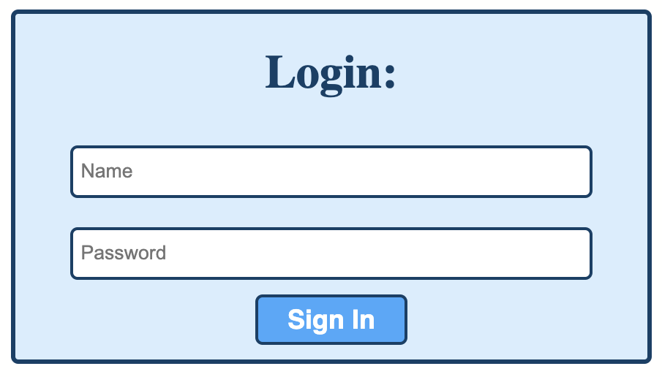
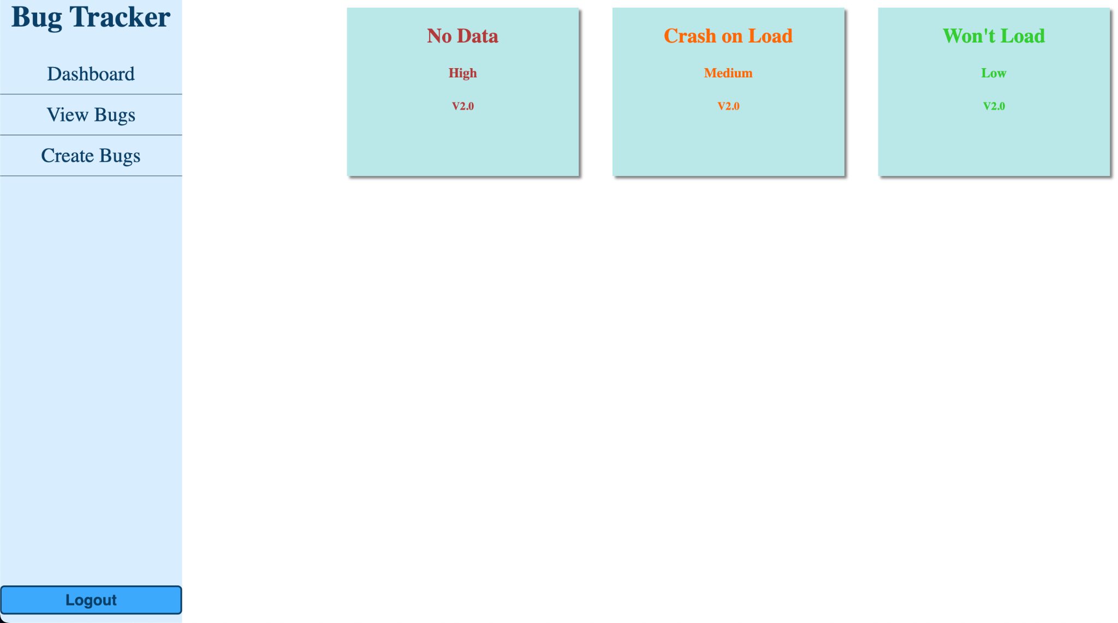
Previews

Slide 6
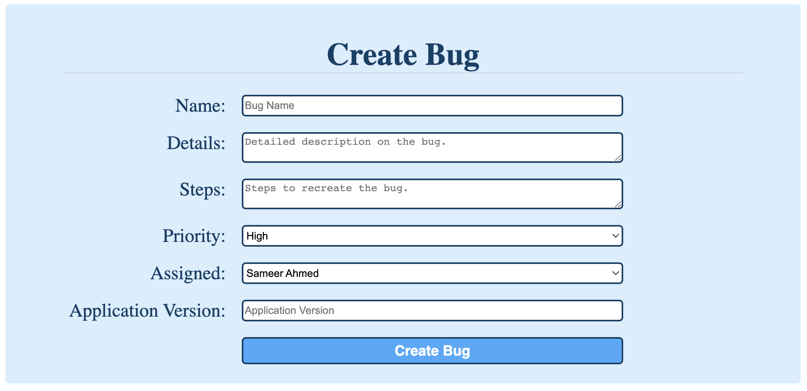
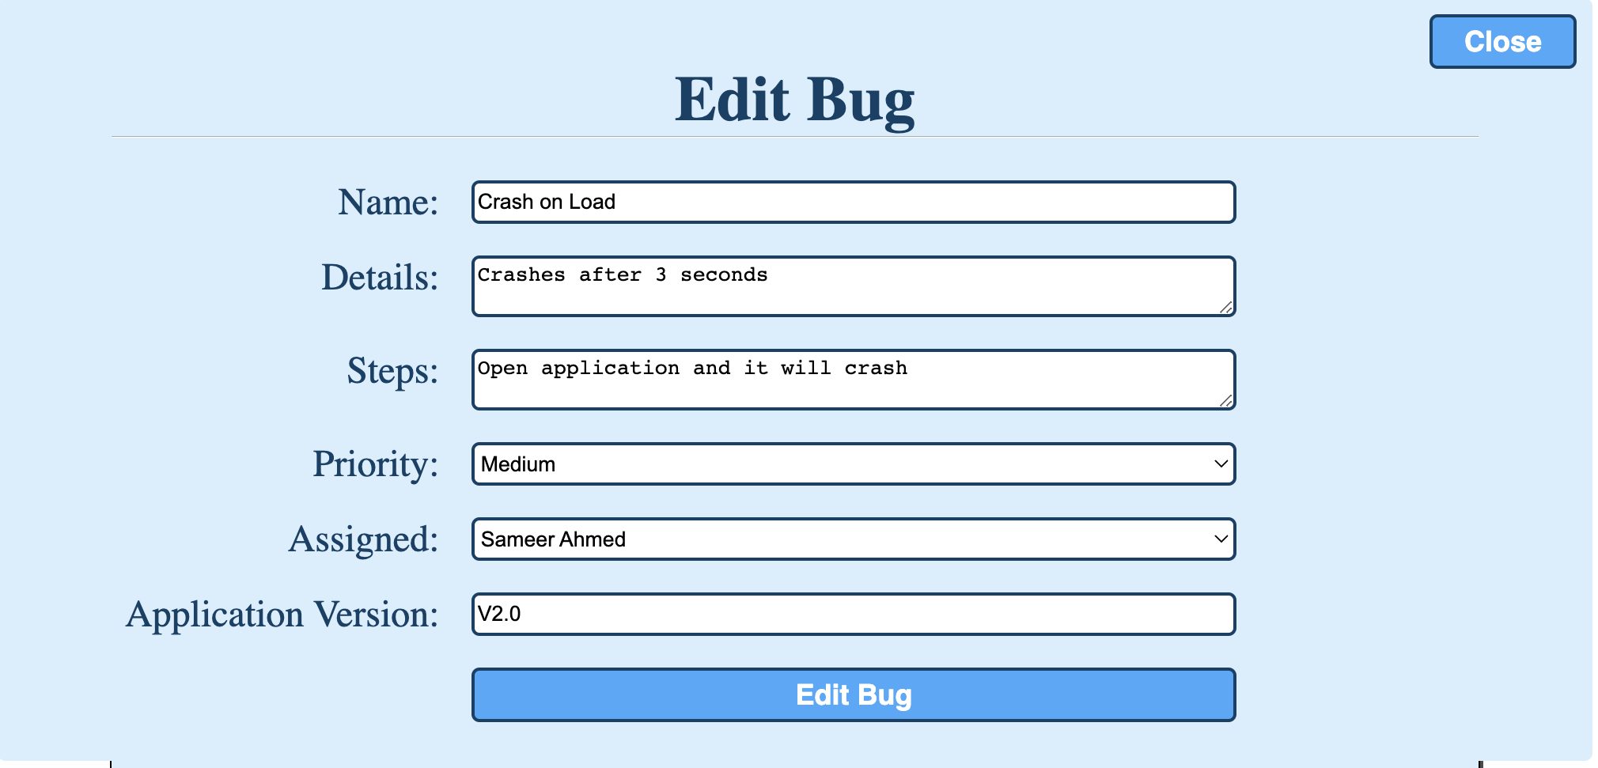
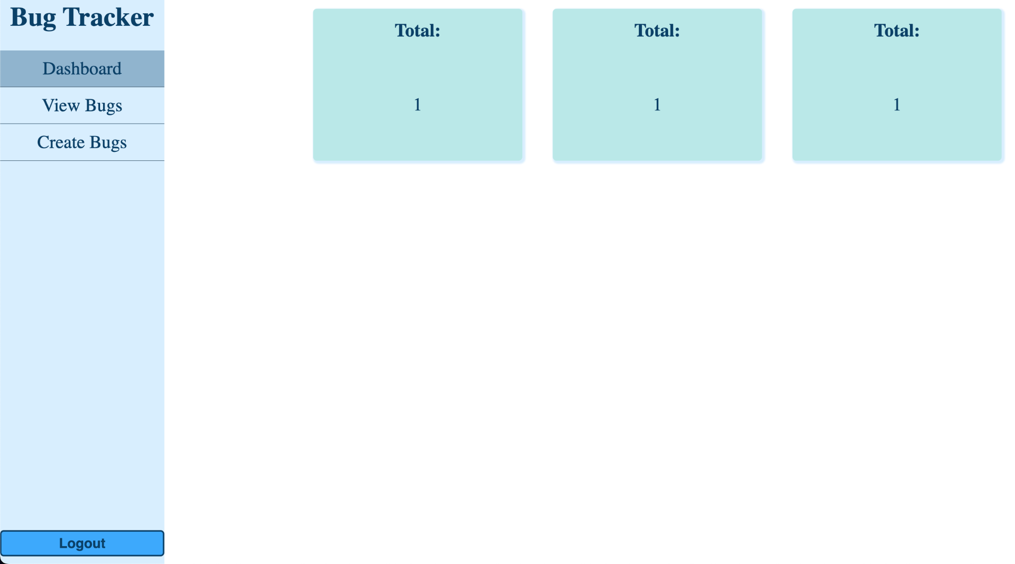
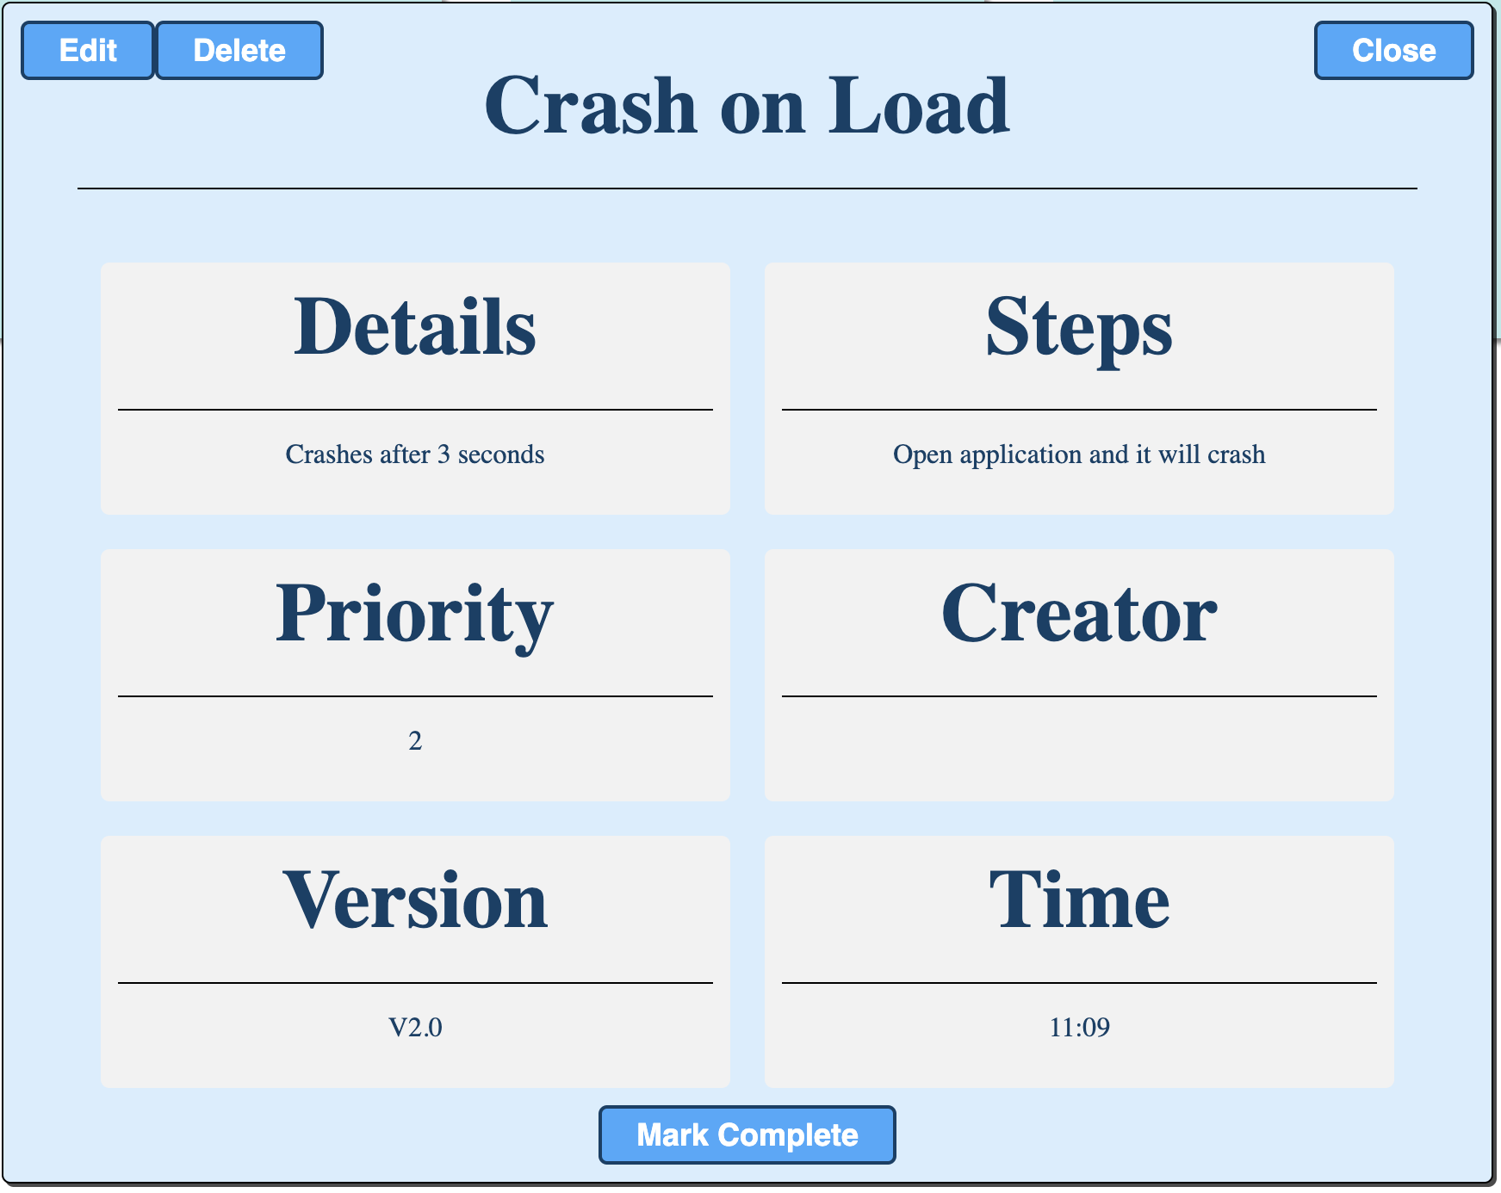
Previews

Slide 7
Problems/ Things I Would Do Better
I the extreme problem I’ve had throughout this problem were that most resources I used were with older versions of React,JS,CSS,HTML so I was basically always looking through the webs the fix the errors.
I would like to in the future add something like Bootstrap to this project since I feel like they’re resources would make the page look way better. I would also add a database/backend portion to make the page just work better in general.

